Slide 1

Software Engineering I Object-Oriented Principles
Dr. Elham Mahmoudzadeh
Isfahan University of Technology
mahmoudzadeh@iut.ac.ir
1403-1, 2024

Slide 2
Object-oriented systems
Focus on capturing the structure and behavior of information systems in little modules that encompass both data and process, called objects.
A class is the general template we use to define and create specific instances, or objects.
Every object is associated with a class.

Slide 3
Three parts of an object
Attributes: describe information about the object.
Behavior: specify what the object can do.
State: defined by the value of its attributes and its relationships with other objects at a particular point in time.

Slide 4
Principles
Abstraction
Encapsulation
Modularity
Inheritance

Slide 5
Abstraction
Is the process of taking away or removing characteristics from something in order to reduce it to a set of essential characteristics.
When you face with the problem, look at the most important things.
Reduce the complexity to understand. Then, refine the problem and focus on the second level of the features.

Slide 6
Encapsulation
Is the combination of process and data into a single entity.
See the class as a black box.
Information required to be passed to the module and the information returned from the module are published.
Exactly how the module implements the required functionality is not relevant. We really do not care how the object performs its functions, as long as the functions occur.
It is used to hide the internal representation of an object from the outside.
You cannot access to data of a class directly, but try to request to the class.
Access level is very important.

Slide 7
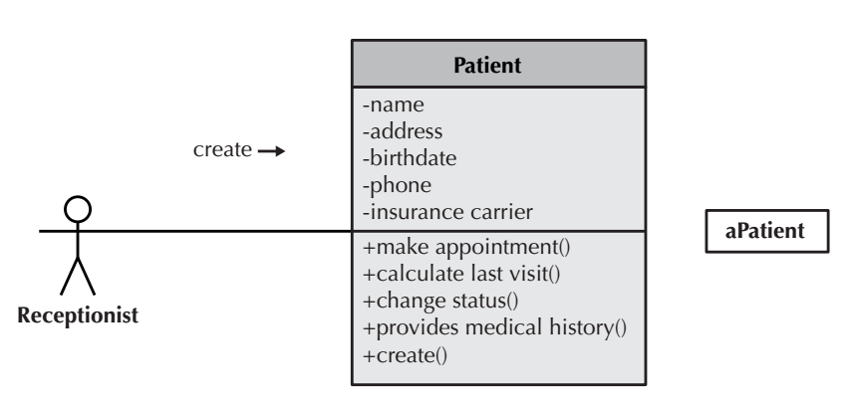
Encapsulation(Cnt’d)
The fact that we can use an object by calling methods is the key to reusability because it shields the internal workings of the object from changes in the outside system, and it keeps the system from being affected when changes are made to an object.
The only information that an object needs to know is the set of operations, or methods, that other objects can perform and what messages need to be sent to trigger them.
Messages are information sent to objects to trigger methods.

Slide 8
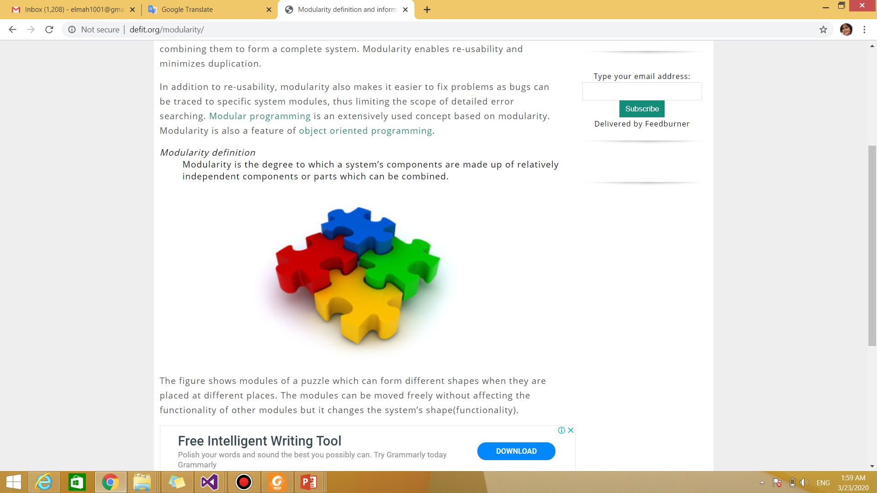
Modularity
Modularity is the degree to which a system’s components are made up of relatively independent components or parts which can be combined.
Decompose a system into the objects that are loosely coupled with each other, connection should be as weak as possible.
Objects should be highly cohesive, it is better for an object to be a single minded entity.

Slide 9
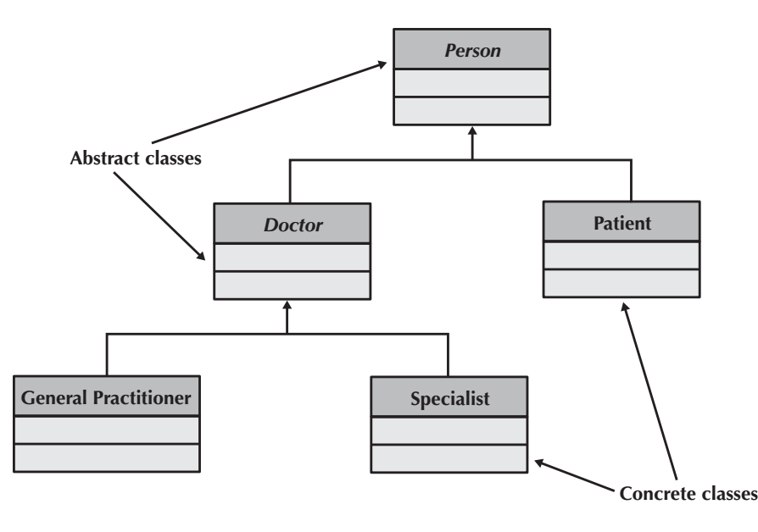
Inheritance
Common sets of attributes and methods can be organized into super classes.
Try to inherit data and operation from superclass.
Makes it simpler to define classes. Instead of repeating the attributes and methods in the subclasses, the attributes and methods that are common are placed in superclass and inherited by the classes below it.

Slide 10
Benefits of Object-Oriented Systems Analysis and Design
Concepts in the object-oriented approach enable analysts to break a complex system into smaller, more-manageable modules, work on the modules individually, and easily piece the modules back together to form an information system.
The modularity makes systems development easier to grasp, easier to share among members of a project team, and easier to communicate to users, who are needed to provide requirements and confirm how well the system meets the requirements throughout the systems development process.
By modularizing, the project, team actually is creating reusable pieces that can be plugged into other systems or used as starting points for other projects. This can save time because new projects don’t have to start completely from scratch.

Slide 11
References
Dennis, Wixon, Tegarden, “System Analysis and Design, An Object Oriented Approach with UML”, 5th Edition, 2015.

Slide 12
What we will talk about next…
Object-Oriented approach

